Slide 1
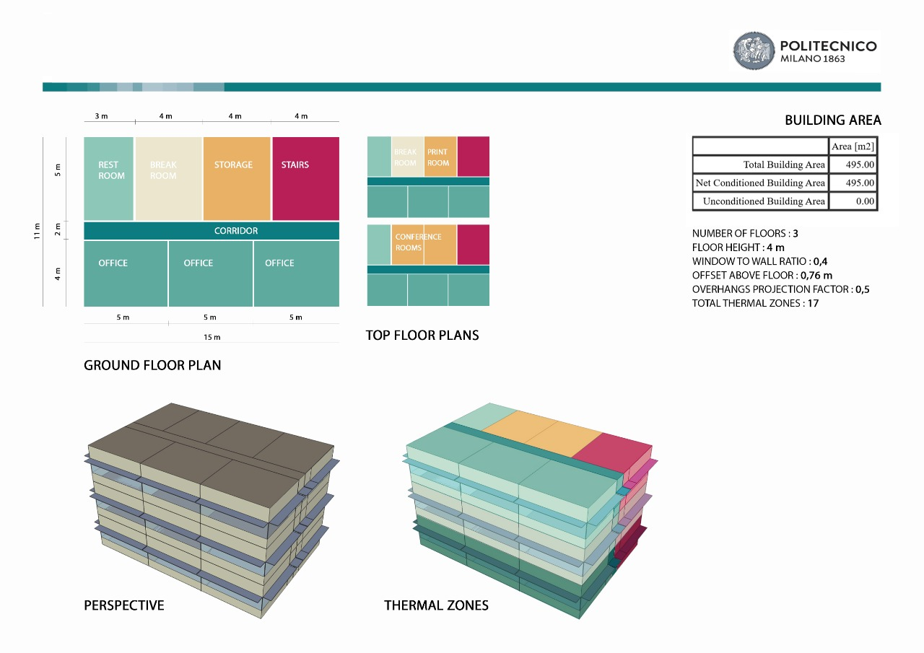
Energetic Simulation
TECHNICAL ENVIRONMENTAL SYSTEMS

Slide 2
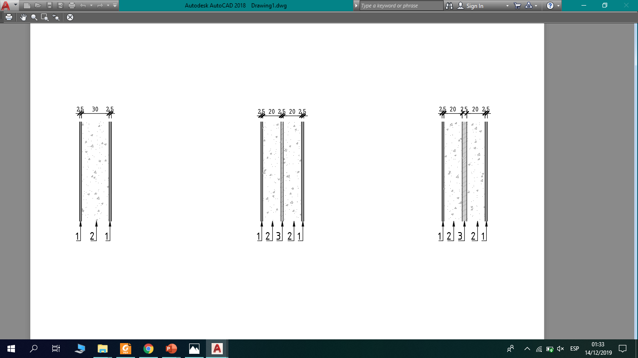
PIACENZA
NEW YORK
KUWAIT
CITIES
3 m
TYPES OF WALLS
Stucco
Concrete wall
Insulated board: foam
WALL 1
WALL 2
WALL 3

Slide 3

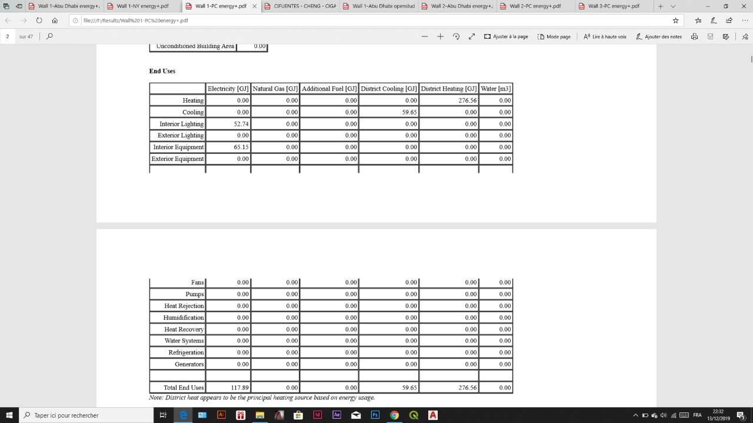
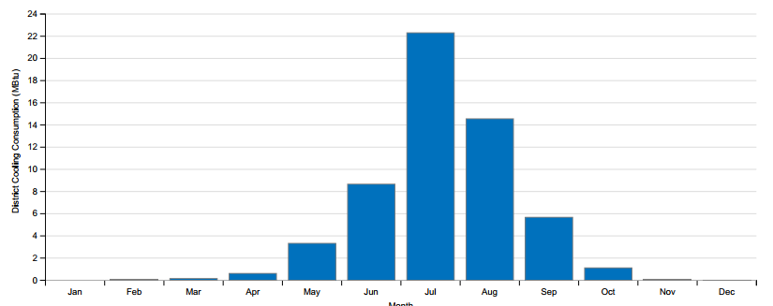
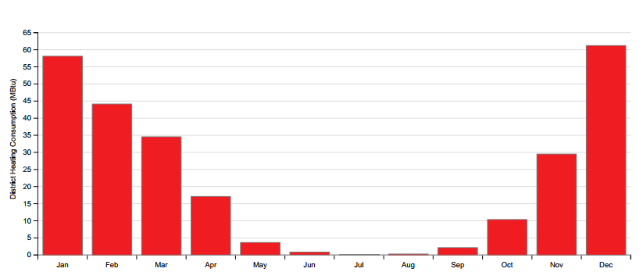
PIACENZA
Max. Temperature: 33.1°C
Min. Temperature: -6°C
Latitude: 44.92°
Longitude: 9.73°
Wall 1
End uses (annual overview)
District cooling consumption (MBtu)
District heating consumption (MBtu)
Total energy GJ
U Factor no Film (W/M2-K)
1 435.64
4.055

Slide 4

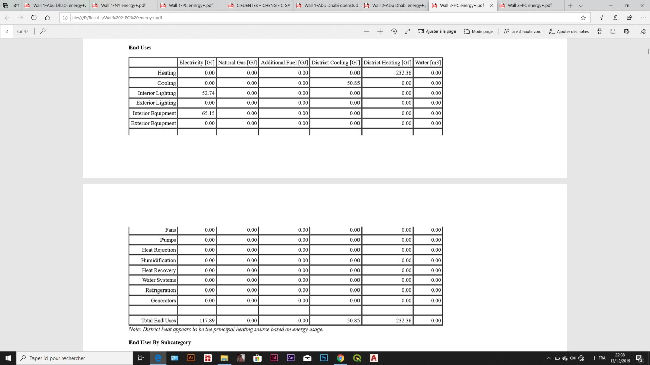
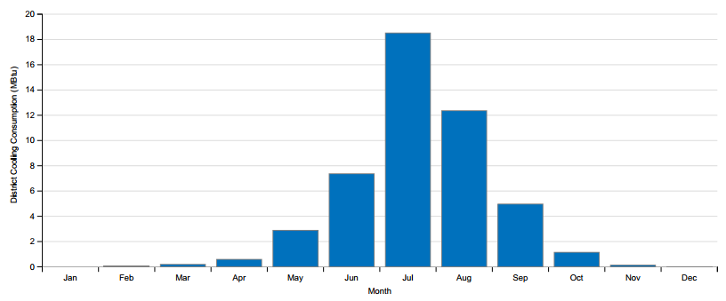
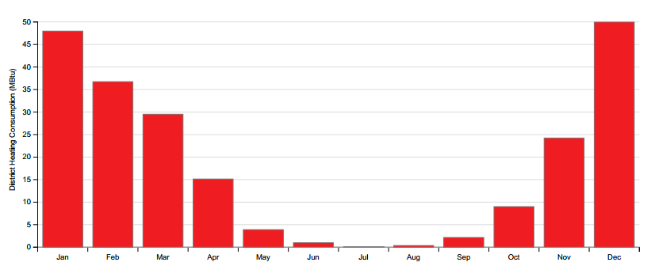
PIACENZA
Max. Temperature: 33.1°C
Min. Temperature: -6°C
Latitude: 44.92°
Longitude: 9.73°
Wall 2
End uses (annual overview)
District cooling consumption (MBtu)
District heating consumption (MBtu)
Total energy GJ
U Factor no Film (W/M2-K)
1 266.64
0.879

Slide 5
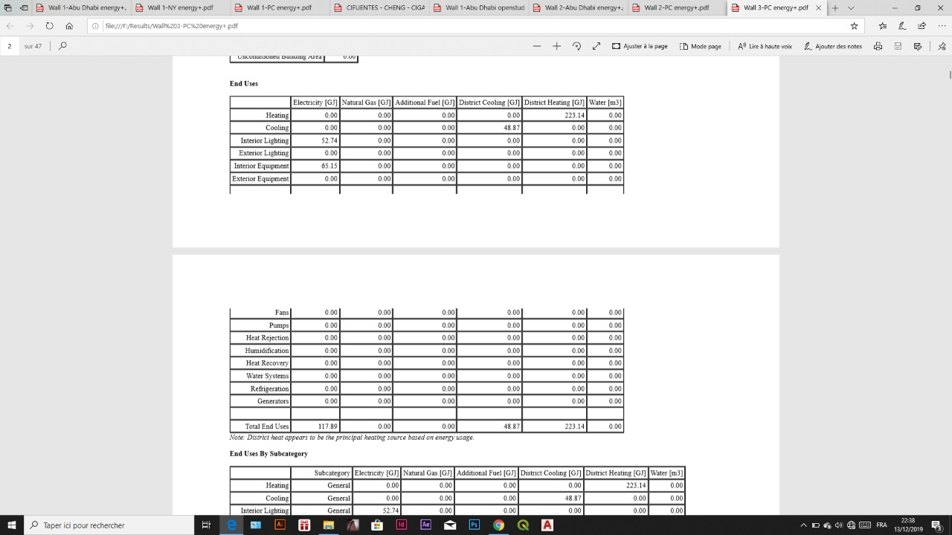
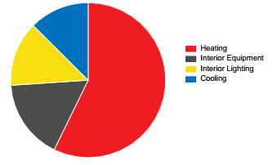
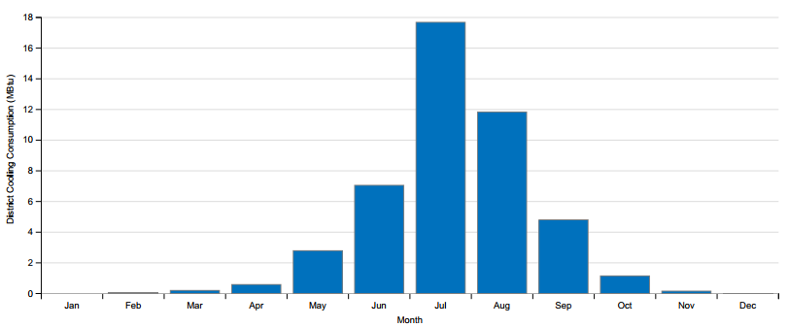
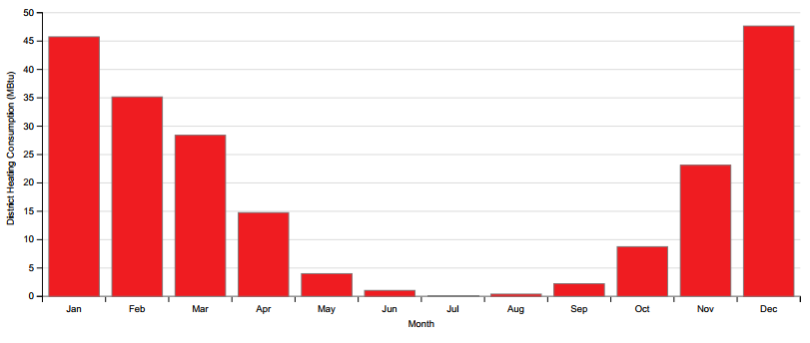
PIACENZA
Max. Temperature: 33.1°C
Min. Temperature: -6°C
Latitude: 44.92°
Longitude: 9.73°
Wall 3
End uses (annual overview)
District cooling consumption (MBtu)
District heating consumption (MBtu)
Total energy GJ
U Factor no Film (W/M2-K)
1 231.24
0.507

Slide 6
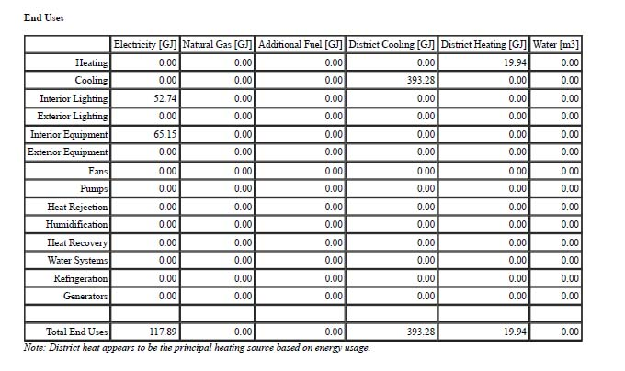
KUWAIT
Max. Temperature: 46°C
Min. Temperature: 8°C
Latitude: 47.65°
Longitude: 29.33°
Wall 1
Total energy GJ
U Factor no Film (W/M2-K)
860.58
4.055

Slide 7
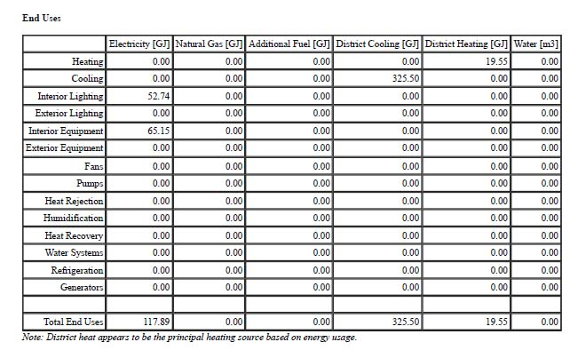
KUWAIT
Max. Temperature: 46°C
Min. Temperature: 8°C
Latitud: 47.65°
Longitude: 29.33°
Wall 2
Total energy GJ
U Factor no Film (W/M2-K)
787.64
0.879

Slide 8
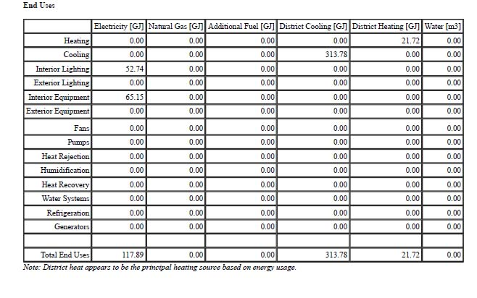
KUWAIT
Max. Temperature: 46°C
Min. Temperature: 8°C
Latitud: 47.65°
Longitude: 29.33°
Wall 3
Total energy GJ
U Factor no Film (W/M2-K)
783.08
0.507

Slide 9
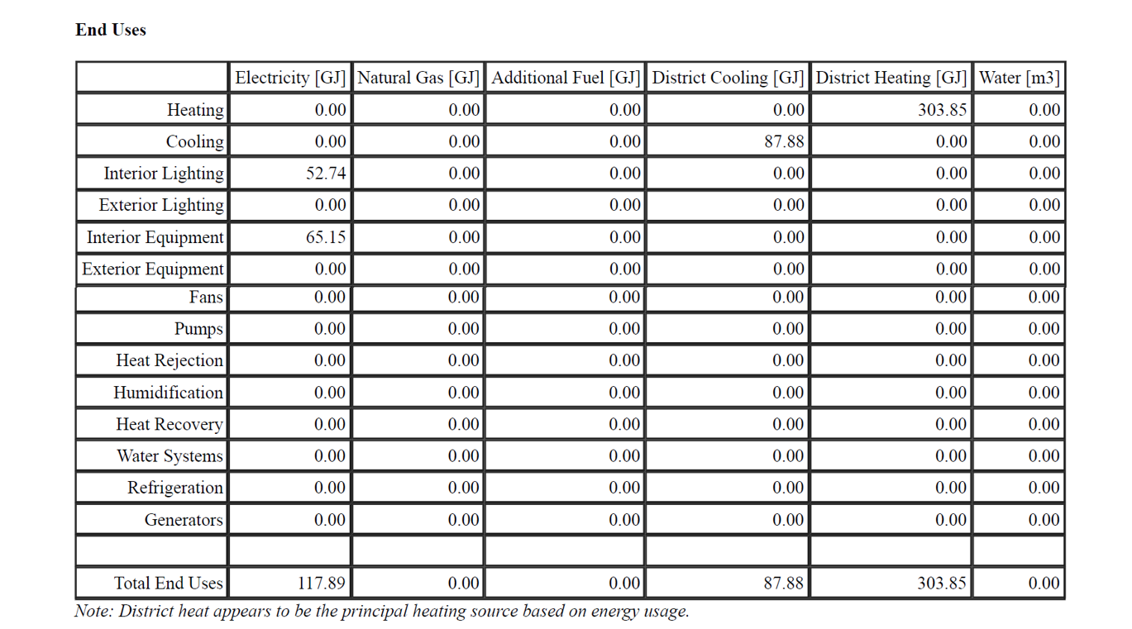
Wall 1/ New York
NEW YORK
Max. Temperatue: 26°C
Min. Temperature: 8°C
Latitude: 40.66°
Longitude: -73.93°
Wall 1
Total energy GJ
U Factor no Film (W/M2-K)
1564.04
4.055

Slide 10
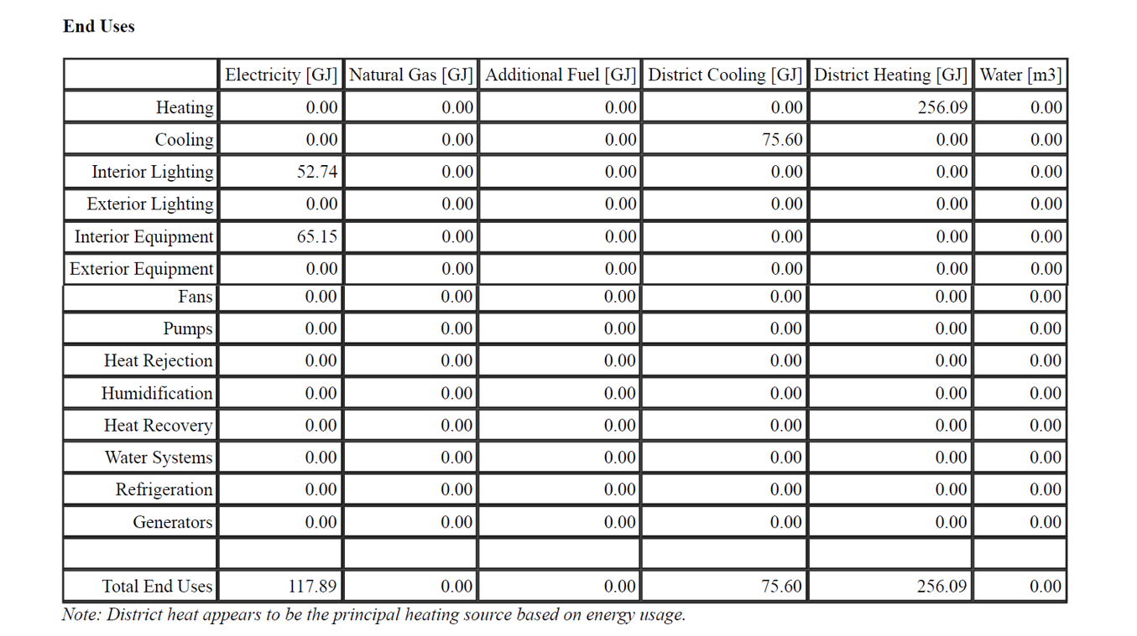
Wall 2/ New York
NEW YORK
Max. Temperatue: 26°C
Min. Temperature: 8°C
Latitude: 40.66°
Longitude: -73.93°
Wall 2
Total energy GJ
U Factor no Film (W/M2-K)
1378.52
0.879

Slide 11
NEW YORK
Max. Temperatue: 26°C
Min. Temperature: 8°C
Latitude: 40.66°
Longitude: -73.93°
Wall 3
Total energy GJ
U Factor no Film (W/M2-K)
1343.50
0.507

Slide 12
Conclusion
Net Source Energy
 | Piacenza | New York | Kuwait
Wall 1 | 1435.64 GJ | 1564.04 GJ | 860.58 GJ
Wall 2 | 1266.64 GJ | 1378.52 GJ | 787.64 GJ
Wall 3 | 1231.24 GJ | 1343.50 GJ | 783.08 GJ
The lowest value: 783.08 GJ - Kuwait
The highest value: 1564.04 GJ - New York
From the table we have the values of the total amount of fuel consumed to operate the building with regards of transmission, delivery, and production losses.
Kuwait has the lowest value with wall 3, meaning that insulated walls in hot weathers is efficient and wastes low amount of energy.
New York has the highest value with wall 1, which means that wall 1 is wasting much energy, as NY is a cold city.

